Slide 1
Passerelles numériques
A Gateway for Life
ER Design

Slide 2
Objectives
Relationships
Entity to table

Slide 3
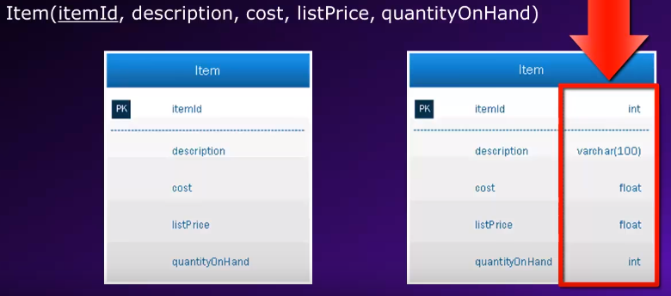
Entity Model
Notes:
Entity as table in database design

Slide 4
Relationship
A relationship is an association among entities.
A relationship type is a meaningful association between entity types.
A teacher teaches students.
A programmer is writing code.
Students play Facebook.
Notes:
In order to implement relationship between tables we need to PK and FK

Slide 5
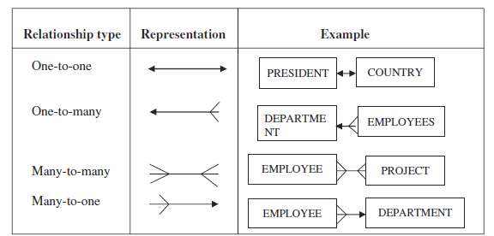
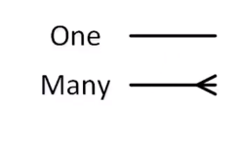
Relationship
One to one
One to many
Many to many

Slide 6
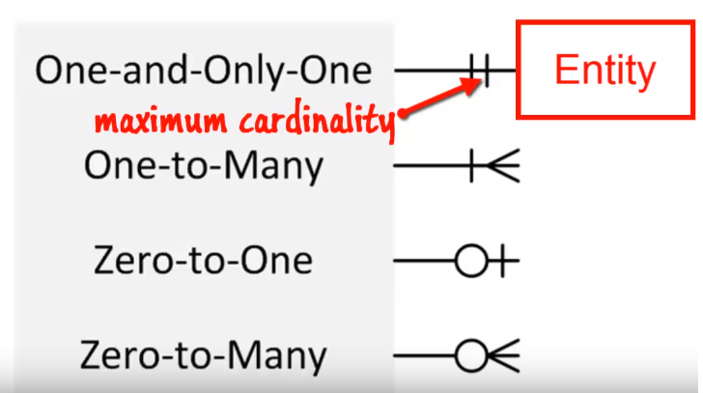
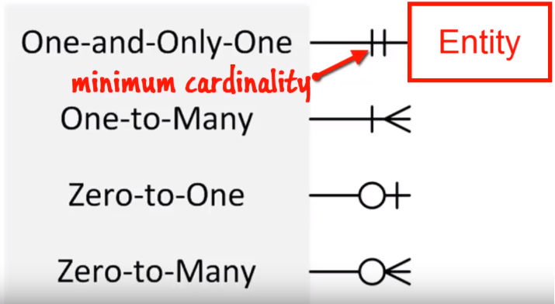
Cardinality

Slide 7
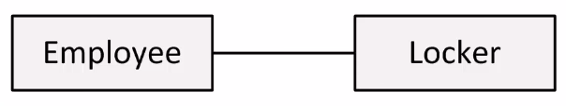
One to One (1:1)
A single instance of an entity is related to a single instance of another entity
Ex:
An Employee has only one locker
A locker is used by only one Employee
Notes:
If both sides of the relationship are optional, it doesn’t matter which table receives the FK
If only one side of the relationship is optional, the optional side receives the FK
In the example is based on the conceptual perception as a human being. Which one does make more sense to you

Slide 8
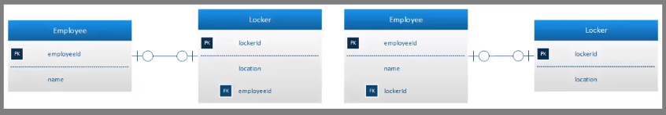
One to One (1:1)
The key from one relation is placed in the other as a Foreign Key (FK)
Notes:
If both sides of the relationship are optional, it doesn’t matter which table receives the FK
If only one side of the relationship is optional, the optional side receives the FK
In the example is based on the conceptual perception as a human being. Which one does make more sense to you

Slide 9
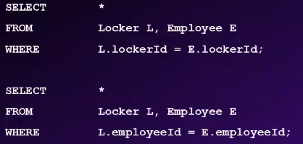
One to One (1:1)
Notes:
If both sides of the relationship are optional, it doesn’t matter which table receives the FK
If only one side of the relationship is optional, the optional side receives the FK
In the example is based on the conceptual perception as a human being. Which one does make more sense to you

Slide 10
Activity
Suppose we have two entities as following:
Patient (patientId, name)
Bed (bedId, location)
There exists the one to one relationship between Patient and Bed
In hospital one patient might need one bed but bed might not be assigned to any patient and if it’s assigned to any patient it will be only one.
Draw the relationship between these two entities
10 minutes

Slide 11
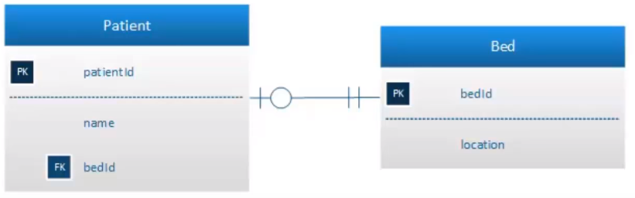
Notes:
Place FK to the optional side which has the minimum cardinality
In hospital one patient might need one bed but bed might not assign to any patient and if it assigned to will be only one.

Slide 12
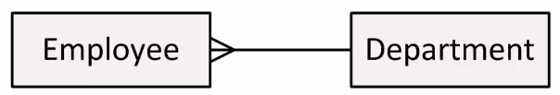
One to Many (1:N)
A single instance of an entity is related to many instances of another entity
Ex:
An employee works in one department
A department can have many employees

Slide 13
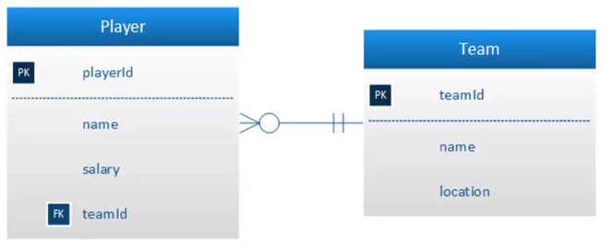
One to Many (1:N)
Like one to one, it is implemented by placing the PK from one table into another table as FK
One to many: FK always goes into the many side of the relationship
Notes:
A team could have many players while a player could play for or belong to only one team.

Slide 14
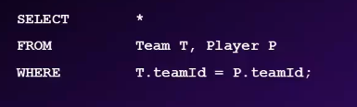
One to Many (1:N)
Notes:
A team could have many players while a player could play for or belong to only one team.

Slide 15
Activity
Suppose we have two entities as following:
Project (projectId, name, startDate, budget)
Manager(managerId, name, phone)
There exists the one to many relationship between Project and Manager
A manager could manages at least one or many projects while a project is managed by one and only one manager
Draw the relationship between these two entities
10 minutes

Slide 16
Project
[PK] projectId
name
startDate
Budget
[FK] manegerId
Manager
[PK] mangerId
name
phone
Notes:
A manager could manage or has many projects while a project is managed by only one manager

Slide 17
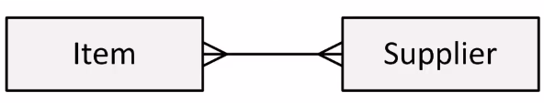
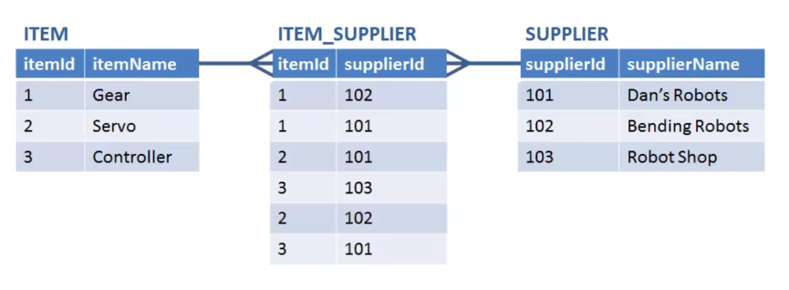
Many to Many (N:M)
Many instances of an entity are related to many instances of another entity
Ex:
A supplier may supply several items
An item may be supplied by several suppliers

Slide 18
Many to Many (N:M)
A new table is created
This table is called an intersection table
An intersection table typically has a composite key comprised of the primary keys from those connected tables

Slide 19
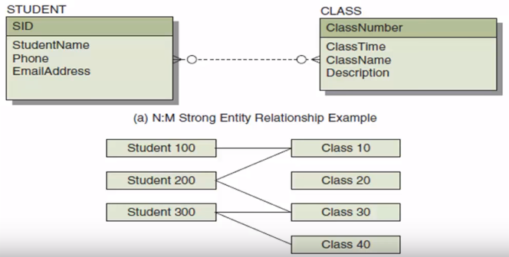
Activity
There exists the many to many relationship between STUDENT and CLASS
A student could study in many classes and a class contains many students
Draw the relationship between these two entities
10 minutes
Notes:
We need to create an intersection table that serves as a look up table between the student and class tables

Slide 20
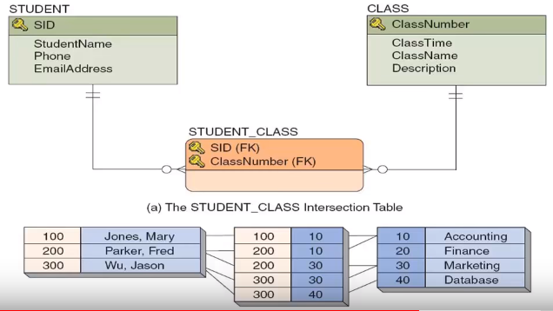
Notes:
We need to join our three table together
It means: a student could take many classes or no class at all and that class is taken by for just one student

Slide 21
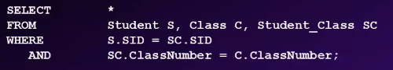
Notes:
We need to join our three table together

Slide 22
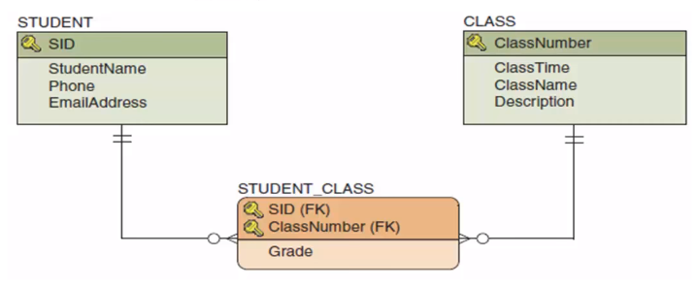
Associative Table
When an intersection table has additional attributes beyond the comprised primary keys that table is called associative table
Notes:
This kind of relationship is called association relationship

Slide 23
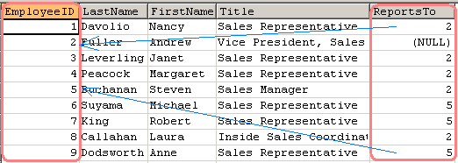
Self referencing relationship

Slide 24
Demo
Design Tables with MySQL Workbench
30 minutes

Slide 25
Activity: Google classroom ER design
30mn using MySQL workbench
Notes:
Homework: room management

Slide 26


